Slide 1
JavaScript MID EXAM 22/4 TIME 3:30-4:45 PM

Slide 2
Using JavaScript in a browser
JavaScript code is included within <script> tags:
<script type="text/javascript">
document.writeln("<h1>Hello World!</h1>")
document.writeln(“all") </script>
Notes:
The type attribute is to allow you to use other scripting languages (but JavaScript is the default)
The semicolon at the end of the JavaScript statement is optional
You need semicolons if you put two or more statements on the same line
It’s probably a good idea to keep using semicolons

Slide 3
JavaScript isn’t always available
Some old browsers do not recognize script tags
These browsers will ignore the script tags but will display the included JavaScript
To get old browsers to ignore the whole thing, use: <script type="text/javascript"> <! This my first prog. document.write("Hello World!") // Stop hiding from older browsers --> </script>
<noscript> this browser not support script tag </noscript>
The <!-- introduces an HTML comment
To get JavaScript to ignore the HTML close comment, -->, the // starts a JavaScript comment, which extends to the end of the line
Some users turn off JavaScript
Use the <noscript> this browser not support script tag </noscript> to display a message in place of whatever the JavaScript would put there

Slide 4
Where to put JavaScript
JavaScript can be put in the <head> or in the <body> of an HTML document
JavaScript functions should be defined in the <head>
This ensures that the function is loaded before it is needed
JavaScript in the <body> will be executed as the page loads
JavaScript functions can be put in a separate .js file
<script src="myJavaScriptFile.js"></script>
Put this in the <head>
An external .js file lets you use the same JavaScript on multiple HTML pages
The external .js file cannot itself contain a <script> tag
JavaScript can be put in an HTML form object, such as a button
This JavaScript will be executed when the form object is used

Slide 5
Data Types
Primitive data types
Number: integer & floating-point numbers
Boolean: true or false
String: a sequence of alphanumeric characters
Composite data types (or Complex data types)
Object: a named collection of data
Array: a sequence of values (an array is actually a predefined object)
Special data types
Null: the only value is "null" – to represent nothing.
Undefined: the only value is "undefined" – to represent the value of an uninitialized variable

Slide 6
Primitive data types
JavaScript has three “primitive” types: number, string, and boolean
Everything else is an object
Numbers are always stored as floating-point values
Hexadecimal numbers begin with 0x
Some platforms treat 0123 as octal, others treat it as decimal
Since you can’t be sure, avoid octal altogether!
Strings may be enclosed in single quotes or double quotes
Strings can contains \n (newline), \" (double quote), etc.
Booleans are either true or false
0, "0", empty strings, undefined and null are false , other values are true

Slide 7
Variables
Variables are declared with a var statement:
var pi = 3.1416, x, y, name = "Dr. Dave" ;
Variables names must begin with a letter or underscore
Variable names are case-sensitive
Variables are untyped (they can hold values of any type)
The word var is optional (but it’s good style to use it)
Variables declared within a function are local to that function (accessible only within that function)
Variables declared outside a function are global (accessible from anywhere on the page)

Slide 8
Operators
Because most JavaScript syntax is borrowed from C (and is therefore just like Java), we won’t spend much time on it
Arithmetic operators (all numbers are floating-point): + - * / % ++ --
Comparison operators: < <= == != >= >
Logical operators: && || ! (&& and || are short-circuit operators)
Bitwise operators: & | ^ ~ << >> >>>
Assignment operators: += -= *= /= %= <<= >>= >>>= &= ^= |=

Slide 9
Increment and Decrement
Both the increment (++) and decrement (- -) operator come in two forms: prefix and postfix
These two forms yield different results
x = 10; x = 10;
y = ++ x; z = x ++;
y = 11
z = 10
x = 11 in both cases

Slide 10
Operators
String operator: +
The conditional operator: condition ? value_if_true : value_if_false
Special equality tests:
== and != try to convert their operands to the same type before performing the test
=== and !== consider their operands unequal if they are of different types
Additional operators (to be discussed): new typeof void delete

Slide 11
Additional operators
New: The new operator is used to create an instance of a user defined object type and to create a dynamic array.
typeof : find the type of a JavaScript variable a variable without a value, has the value undefined.
Void : The void operator is used to evaluate a JavaScript expression without returning a value.
Delete: The delete operator deletes an object, an object's property, or an element from an array.
The operator can also delete variables which are not declared with the var statement

Slide 12
Comments
The syntax for a single-line comment is: // comment text
The syntax of a multi-line comment is: /* comment text covering several lines */

Slide 13
Statements, I
Most JavaScript statements are also borrowed from C
Assignment: greeting = "Hello, " + name;
Compound statement: { statement; ...; statement }
If statements: if (condition) statement; if (condition) statement; else statement;
Familiar loop statements: while (condition) statement; do statement while (condition); for (initialization; condition; increment) statement;

Slide 14
Statements, II
The switch statement: switch (expression) { case label : statement; break; case label : statement; break; ... default : statement; }
Other familiar statements:
break;
continue;
The empty statement, as in ;; or { }

Slide 15
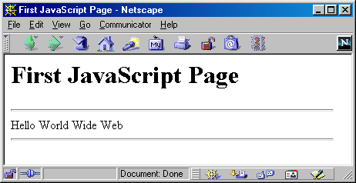
A Simple Script
<html>
<head><title>First JavaScript Page</title></head>
<body>
<h1>First JavaScript Page</h1>
<script type="text/javascript">
document.write("<hr>");
document.write("Hello World Wide Web");
document.write("<hr>");
</script>
</body>
</html>

Slide 16
Embedding JavaScript
<html>
<head><title>First JavaScript Program</title></head>
<body>
<script type="text/javascript"
src="your_source_file.js"></script>
</body>
</html>
Inside your_source_file.js
document.write("<hr>");
document.write("Hello World Wide Web");
document.write("<hr>");
Use the src attribute to include JavaScript codes from an external file.
The included code is inserted in place.

Slide 17
document.writeln
<HTML>
<!– Welcome to JavaScript
<HEAD>
<TITLE> Welcome to JavaScript </TITLE>
<SCRIPT TYPE="text/javascript">
document.writeln("<FONT COLOR='magenta' size='+3'>Welcome to JavaScript Programming!</font>" );
</SCRIPT>
</HEAD>
</HTML>
good morning

Slide 18

document.write
<HTML>
<HEAD>
<TITLE> Using document.write </TITLE>
<SCRIPT TYPE="text/javascript">
document.writeln( "<H1>Welcome to ");
document.write( "JavaScript Programming!</H1>" );
</SCRIPT>
</HEAD>
</HTML>

Slide 19
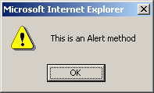
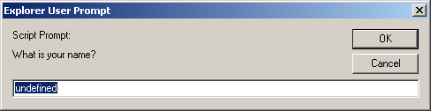
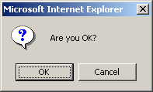
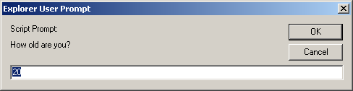
alert(), confirm(), and prompt()
<script type="text/javascript">
alert("This is an Alert method");
confirm("Are you OK?");
prompt("What is your name?");
prompt("How old are you?","20");
</script>

Slide 20
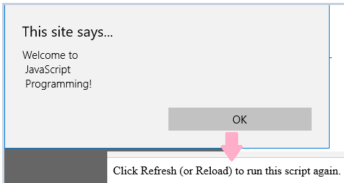
window.alert
alert("Text to be displayed");
Display a message in a dialog box
<HTML>
<HEAD>
<TITLE> Using window.alert </TITLE>
<SCRIPT TYPE="text/javascript">
window.alert( "Welcome to \n JavaScript \n Programming!" );
</SCRIPT>
</HEAD>
<BODY>
<P>Click Refresh (or Reload) to run this script again.</P>
</BODY>
</HTML>

Slide 21
confirm
A confirm box is often used if you want the user to verify or accept something.
Example:
var r = confirm("Press a button"); if (r == true) { x = "You pressed OK!"; } else { x = "You pressed Cancel!"; }
var answer = confirm(“ statement ?“, default);
Display a message in a dialog box with two buttons: "OK" or "Cancel".
confirm() returns true if the user click "OK". Otherwise it returns false

Slide 22
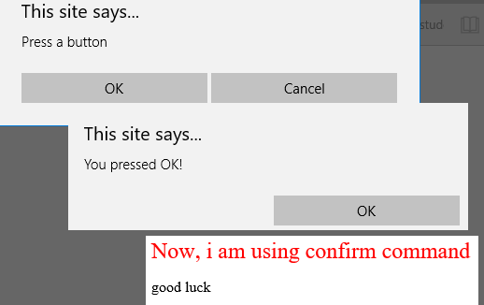
Confirm Example
<head>
<SCRIPT TYPE="text/javascript">
var r=confirm("Press a button");
if (r == true) {x = "You pressed OK!";}
else
{ x = "You pressed Cancel!";}
window.alert(x);
</script>
</head>
<body>
<font color='red' size=+2>Now, i am using confirm command</font>
<p>good luck </p>
</body>

Slide 23
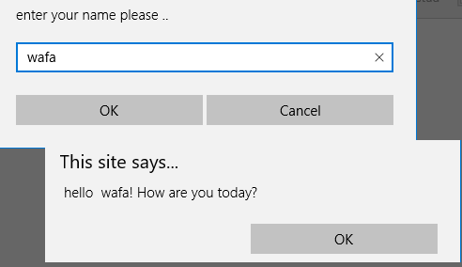
Prompt Box
A prompt box is often used if you want the user to input a value before entering a page.
window.prompt("sometext","defaultText");
<SCRIPT>
var person = prompt("Please enter your name", "Harry Potter");
if (person != null)
{ alert( "Hello " + person + "! How are you today?");
}
</SCRIPT>

Slide 24
User input/output
<SCRIPT TYPE="text/javascript">
var firstNumber, // first string entered by user
secondNumber, // second string entered by user
number1, // first number to add
number2, // second number to add
sum; // sum of number1 and number2
// read in first number from user as a string
firstNumber = window.prompt("Enter first integer", "0" );
// read in second number from user as a string
secondNumber = window.prompt( "Enter second integer", "0" );
// convert numbers from strings to integers
firstNumber = parseInt(firstNumber);
number2 = parseInt( secondNumber );
// add the numbers
sum = firstNumber + number2;
// display the results
document.writeln( "<H1>The sum is " + sum + "</H1>" );
</SCRIPT>

Slide 25
Window Location
The window.location object can be used to get the current page address (URL) and to redirect the browser to a new page.

Slide 26
Window Location
The window.location object can be written without the window prefix.
Other location options:
window.location.href returns the href (URL) of the current page
window.location.hostname returns the domain name of the web host
window.location.pathname returns the path and filename of the current page
window.location.protocol returns the web protocol used (http:// or https://)
window.location.assign loads a new document

Slide 27
Window Location Example
<h1 align ="center" >Enjoy with the window.location command </h1>
<script>
document.write("the Page href is ","<br>");alert(window.location.href);
document.write("the Page domain name is ","<br>");alert(window.location.hostname);
document.write("the Page path and file name is ","<br>");alert(window.location.pathname);
document.write("the Page protocol is ","<br>");alert(window.location.protocol);
document.write("the Page loads a new document is ","<br>");
alert(window.location.assign("C:/Users/aa/Desktop/backg.jpeg"));
/* document.write("the Page loads a google site: ","<br>");
confirm(window.location.assign("http://www.google.jo/"));*/
</script>

Slide 28
Function
A JavaScript function is a block of code designed to perform a particular task.
A JavaScript function is defined with the function keyword, followed by a name, followed by parentheses ().
The parentheses may include parameter names separated by commas: (parameter1, parameter2, ...)
The code to be executed, by the function, is placed inside curly brackets: {}
function name(parameter1, parameter2, parameter3)
{ code to be executed
}

Slide 29
Example _1
<script>
function myFunction(message)
{
alert(message);
}
myFunction("Welcome to JavaScript!");
document.write("After the first call");
var msg = "Second call to myFunction!";
myFunction(msg);
</script>

Slide 30
Example _2
<SCRIPT TYPE = "text/javascript">
var input1 = window.prompt( "Enter first number", "0" );
var input2 = window.prompt( "Enter second number", "0" );
var value3 = parseFloat (window.prompt( "Enter third number", "0" ));
var value1 = parseFloat( input1 );
var value2 = parseFloat( input2 );
var maxValue = maximum( value1, value2, value3 );
document.writeln( "First number: " + value1 +
"<BR>Second number: " + value2 +
"<BR>Third number: " + value3 +
"<BR>Maximum is: " + maxValue );
// maximum method definition (called from above)
function maximum( x, y, z )
{
return Math.max( x,y,z);
}
</SCRIPT>

Slide 31
Example _2
<script>
function square(number)
{
return number * number;
}
var Sqr = square(2);
document.write("Square (2) = " + Sqr + "<br>");
document.write ("Square (4) = " +square(Sqr));
</script>

Slide 32
Random Numbers Math.random()
Math.random() returns a random number between 0 (inclusive), and 1 (exclusive).
ex:- document.write( Math.random());
JavaScript Random Integers Math.floor()
Math.random() used with Math.floor() can be used to return random integers :
Ex:-
return a random integer value between 0 and 10:- document.write(Math.floor(Math.random() * 10));
return a random integer value between 1 and 11:- document.write(Math.floor(Math.random() * 11)+1);

Slide 34
Math.random()*30-10 -10…20→ 0..30 → -10→ -10…20

Slide 35
X=Math.random()*15+20
0..1 → *15 ==( 0…15 )-===(20…35)
20…35
X=Math.floor(Math.random()*10-2)
-2→8 …..(0…10) -2 -→( -2 .. 8)

Slide 36
Random Example
<SCRIPT TYPE="text/javascript">
var value;
document.write("<H1>Simple Random Numbers Program </H1>");
document.write("<br>" );
document.write("generate a random number between 0..1 as".fontcolor("red"),"<br>");
document.write(Math.random());
document.write("<br>","<br>" );
document.write("generate a random number between 0..7 use Maths.random()*7 as".bold().fontcolor("green"),"<br>")
document.write(Math.random()*7);
document.write("<br>","<br>" );
document.write("generate a random number between 1..15 use Maths.random()*15+1 as".link().fontcolor("blue"),"<br>")
document.write(Math.random()*15+1);
</SCRIPT>

Slide 37
Random Numbers
<SCRIPT TYPE="text/javascript">
var value;
document.writeln( "<H1>Random Numbers</H1>" +
"<TABLE BORDER = '1' WIDTH = '50%'><TR>" );
for ( var i = 1; i <= 20; i++ )
{
value = Math.floor( 1 + Math.random() * 6 );
document.writeln( "<TD>" + value + "</TD>" );
if ( i % 5 == 0 )
document.writeln( "</TR><TR>" );
}
document.writeln( "</TR></TABLE>" );
</SCRIPT>

Slide 38
JavaScript Arrays
JavaScript arrays are used to store multiple values in a single variable.
var cars = ["Saab", "Volvo", "BMW"];
var cars = new Array("Saab", "Volvo", "BMW");
var cars = new Array(3);
This statement modifies the first element in cars array:
cars[0] = "Opel";
var x = cars.length;

Slide 39
Array Examples
var Car = new Array(3);
Car[0] = "Ford";
Car[1] = "Toyota";
Car[2] = "Honda";
// Create an array of three elements with initial
// values
var Car2 = new Array("Ford", "Toyota", "Honda");
// Create an array of three elements with initial
// values
var Car3 = ["Ford", "Toyota", "Honda"];

Slide 40
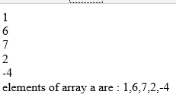
Example_Read-Print array elements
<script>
a=new Array(5);
for(i=0;i<5;i++)
{a[i]=parseInt(prompt("enter the array element a["+i+"] <br>"));}
for(i=0;i<5;i++)
{document.write(a[i],"<br>");}
document.write("elements of array a are : ",a,"<br>");
</script>

Slide 41

Example_Sum of array elements
<head><script>
function sum(ab)
{sum=0;
for(i=0;i<5;i++)
sum=sum+ab[i];
return sum;
}
</script></head>
<body><script>
a=new Array(5);
a[1]=5;
for(i=0;i<5;i++)
a[i]=parseInt(prompt("enter the array element a["+i+"] <br>"));
for(i=0;i<5;i++)
document.write(a[i],"<br>");
document.write("<br><br> sum= ",sum(a),"<br>");
</script></body>

Slide 42

Example_Max of array elements
<head><script>
function max(ab)
{max=ab[0];
for(i=1;i<5;i++)
if(ab[i]>max) {max=ab[i];}
return max;
}
</script></head>
<body><script>
a=new Array(5);
a[1]=5;
for(i=0;i<5;i++)
a[i]=parseInt(prompt("enter the array element a["+i+"] <br>"));
for(i=0;i<5;i++)
document.write(a[i],"<br>");
document.write("<br><br> max= ",max(a),"<br>");
</script></body>

Slide 43

Example_Switch on array elements
<body> <script>
a=new Array(5);
ac=bc=0;
for(i=0;i<5;i++)
{
a[i]=prompt("enter the array element a["+i+"] (awes or belal) <br>");
document.write(a[i],"<br>");
switch (a[i])
{
case "awes“ :ac++; break;
case "belal": bc++; break;
}
}
document.write("<br><br> awes= ",ac,"<br>");
document.write("<br><br> belal= ",bc,"<br>");
</script></body>

Slide 44
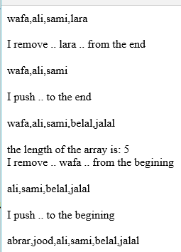
Example using array commands: pop,push,shift,unshift
<script type="text/javascript">
var aa=new Array(4);
aa[0]="wafa";
aa[1]="ali";
aa[2]="sami";
aa[3]="lara";
document.write(aa,"<br>","<br>");
document.write("I remove .. "+aa.pop()," .. from the end ");
document.write("<br><br>",aa);
document.write("<br><br>","I push "," .. to the end ");
aa.push("belal","jalal")
document.write("<br><br>",aa);
document.write("<br><br>","the length of the array is: ",aa.length,"<br>");
document.write("I remove .. "+aa.shift()," .. from the begining ");
document.write("<br><br>",aa);
document.write("<br><br>","I push "," .. to the begining ");
aa.unshift("abrar","jood")
document.write("<br><br>",aa);
</script>

Slide 45
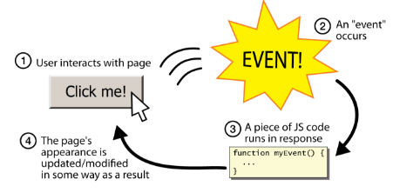
Event-driven Programming
JS programs have no main; they respond to user actions called events
event-driven programming: writing programs driven by user events

Slide 46

Buttons: <button>
To make a responsive button or other UI control:
Choose the control (e.g. button) and event (e.g. mouse click) of interest
Write a JavaScript function to run when the event occurs
Attach the function to the event on the control

Slide 47
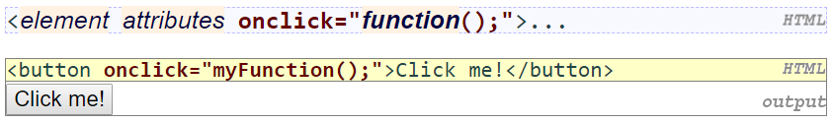
Event Handlers
JavaScript functions can be set as event handlers
when you interact with the element, the function will execute
onclick is just one of many event HTML attributes we'll use

Slide 48
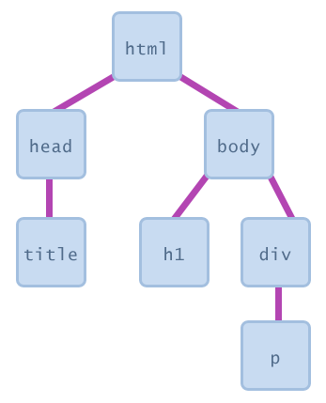
Document Object Model (DOM)
A set of JavaScript objects that represent each element on the page.
Most JS code manipulates elements on an HTML page
We can examine elements' state
e.g. see whether a box is checked
we can change state
e.g. insert some new text into a div
we can change styles

Slide 49
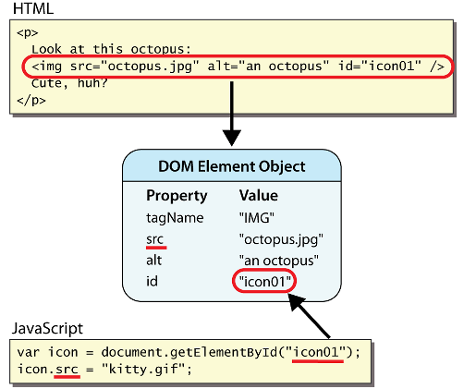
DOM Element Objects
every element on the page has a corresponding DOM object
access/modify the attributes of the DOM object with objectName.attributeName

Slide 50
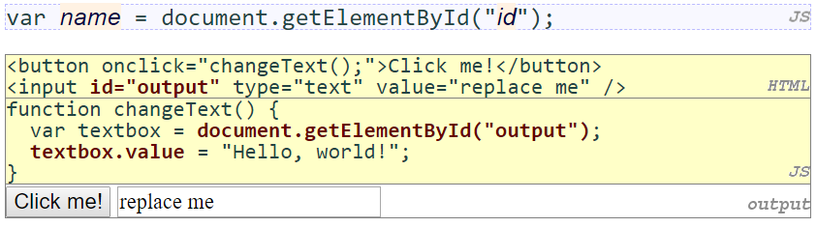
Accessing element: document.getElementById
document.getElementById returns the DOM object for an element with a given id
can change the text in most form controls by setting the value property

Slide 51
Example
can change the text inside most elements by setting the innerHTML property
<button onclick="swapText();">Click me!</button>
<p id="output2">Hello</p>
<input id="textbox2" type="text" value="Goodbye">
function swapText() {
var span = document.getElementById("output2");
var textBox = document.getElementById("textbox2");
var temp = span.innerHTML;
span.innerHTML = textBox.value;
textBox.value = temp;
}

